Slide 1
Image Scraping and Classification Project
Name: Sumit Santra
SME: Shubham Yadav

Slide 2
Problem Statement
Images are one of the major sources of data in the field of data science and AI. This field is making appropriate use of information that can be gathered through images by examining its features and details. We are trying to give you an exposure of how an end to end project is developed in this field.
The idea behind this project is to build a deep learning-based Image Classification model on images that will be scraped from e-commerce portal. This is done to make the model more and more robust.

Slide 3
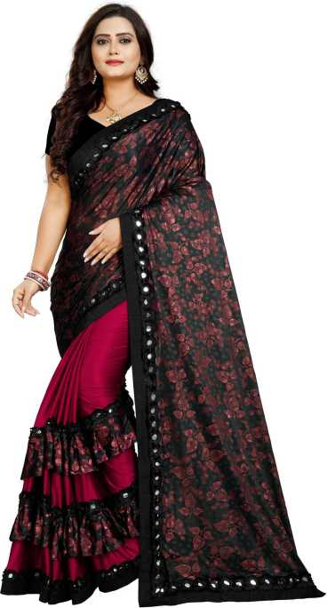
Visualization of Saree Image
Information About Saree Image
Image
This image is of Saree I Scraped it from Flipkart (a ecommerce website)
Using Python and Selenium I scraped the images
Each Image Category has 1000 images from which 88 of the images are used for testing set

Slide 4
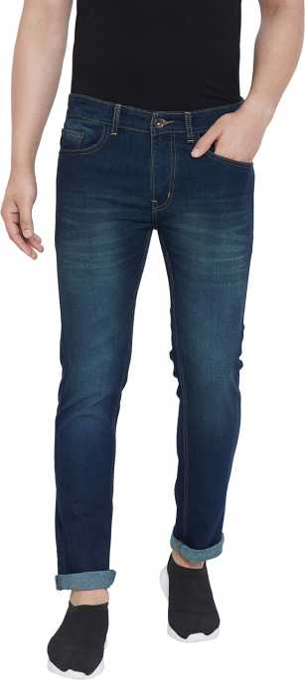
Visualization of Jeans Image
Information about Jeans Image
Jeans Image
This image is of Saree I Scraped it from Flipkart (a ecommerce website)
Using Python and Selenium I scraped the images
Each Image Category has 1000 images from which 88 of the images are used for testing set

Slide 5
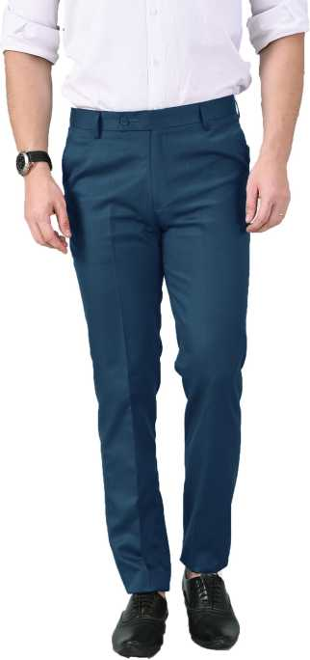
Visualization of Trouser Image
Information about Trouser Image
Trouser Image
This image is of Saree I Scraped it from Flipkart (a ecommerce website)
Using Python and Selenium I scraped the images
Each Image Category has 1000 images from which 88 of the images are used for testing set

Slide 6
Algorithms used
VGG16: VGG16 is a convolution neural net (CNN ) architecture which was used to win ILSVR(Imagenet) competition in 2014. It is considered to be one of the excellent vision model architecture till date. ... It follows this arrangement of convolution and max pool layers consistently throughout the whole architecture.
InceptionV3: Inception v3 is a widely-used image recognition model that has been shown to attain greater than 78.1% accuracy on the ImageNet dataset. The model is the culmination of many ideas developed by multiple researchers over the years.
Resnet50: ResNet50 is a variant of ResNet model which has 48 Convolution layers along with 1 MaxPool and 1 Average Pool layer. It has 3.8 x 10^9 Floating points operations. It is a widely used ResNet model and we have explored ResNet50 architecture in depth.

Slide 7
Problem Solving Approach
I first thought that it will be easy to scrape images from the e-commerce site by because of load on flipkart it was giving me errors so it took time for that to solve.
I lowred the pixel density by dividing all the images with 255 so that the image pixel can be between 0-1 so that the Convolution can be fast.
Then I scraped 500 images and I was not getting that good accuracy for my model so after that I scraped all the pages of the particular model and after scraping all the images my model gave 99.24% accuracy.
So in this step I only used try and error technique to get a good accuracy.

Slide 8
Limitation of the Project
This model has some limitations as this model is only trained on 3 categories of products so it can only classify 3 categories if we pass other product images it can classify Wrongly.
To improve the model accuracy we can train the model on more data from different websites.
To teach our model more categories we need to feed our model with more categories and our model will perform good on other product as well.

